Slide 1

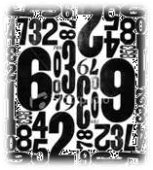



Quantitative
Data Analysis
Presenter: ASMA MUHAMAD FARHANA BINTI YAAKUB

Slide 2
INTRODUCTION
1.0
Quantitative analysis involves the techniques by which researchers convert data to numerical forms and subject them to statistical analyses.
Involves techniques
Involve task of converting data into knowledge
Myths:
x Complex analysis and BIG WORDS impress people
x Analysis comes at the end after all the data are collected
x Data have their own meaning.

Slide 3

QUANTIFICATION OF DATA
2.0
The numerical representation and manipulation of observations for the purpose of describing and explaining the phenomena that those observation reflect.
(Babbie, 2010, p. 422)

Slide 4
Data Preparation
2.1
EDITING
MISSING DATA
CODING & DATA ENTRY
DATA TRANSFORM
Data must be inspected for completeness and consistency.
E.g. a respondent may not answer the question on marriage.
But in other questions, respondent answers that he/she had been married for 10 years and has 3 children
Elimination of questionnaire (missing >10% of the total response)
Involves quantification (process of converting data into numerical form)
E.g. Male – 1, Female – 2
Changing data into new format. E.g. reduce 5 Likert- type Scale into 3 categories

Slide 5
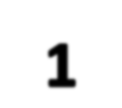
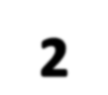
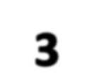



Types of Variables Analysis
2.2
One variable
(Univariate)
E.g. Age, gender, income etc.
Two variables
(Bivariate)
E.g. gender & CGPA
several variables (Multivariate)
E.g. Age, education, and prejudice
UNIVARIATE ANALYSIS
BIVARIATE ANALYSIS
MULTIVARIATE ANALYSIS

Slide 6
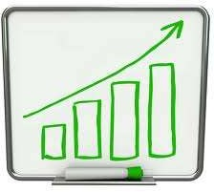
UNIVARIATE ANALYSIS
3.0
Univariate analysis is the analysis of a single variable.
Because Univariate Analysis does not involve relationships between two or more variables, its purpose is more toward descriptive rather than explanatory.

Slide 7
Distribution
3.1
Frequency distribution is counts of the number of response to a question or to the occurrence of a phenomenon of interest.
(Polonsky & Waller, 2011, p. 189)
Obtained for all the personal data or classification variables. (Babbie, 2010, p. 428)
Gives researcher some general picture about the dispersion, as well as maximum and minimum response.

Slide 8
Distribution (cont’)
1. What is your religious preference?
1 Protestant 2 Catholic 3 Jewish 4 None 5 Other
TABLE 3.1: Religious Preferences
Frequency Percent ^{Valid} |  |  |  | Cumulative
 |  |  | Percent | Percent
1 Protestant | 886 | 59.6 | 60.0 | 60.0
2 Catholic | 367 | 24.7 | 24.8 | 84.8
3 Jewish | 26 | 1.7 | 1.8 | 86.6
4 None | 146 | 9.8 | 9.9 | 96.5
5 Other | 52 | 3.5 | 3.5 | 100.0
Total | 1477 | 99.4 | 100.0
Missing 9 NA | 9 | 0.6
Total | 1486 | 100.0
Gusukuma, 2012. University of Mary Hardin-Baylor

Slide 9
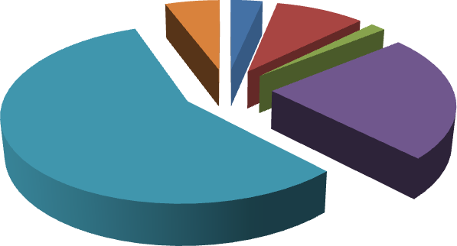
Distribution (cont’)
FIGURE 3.2: Religious Preferences
Missing 6%
Other None 3% 9%
Jewish
2%
Catholic 23%
Protestant 57%

Slide 10

Central Tendency
3.2
Present data in form of an average:
1. Mean =
2. Mode = most frequently occurring attribute
3. Median =
Middle attribute in the ranked distribution of observed attribute

Slide 11
Central Tendency (cont’)
Age GPA Gender Hours
AGE OF RESPONDENTS
1 Dick 20 1.9 M 1
2 Edward 19 1.5 M 1
Emmett 20 2.1 M 2
Lauren 20 2.4 F 3 5 Mike 19 2.75 M 4
6 Benjie 18 3 M 4 7 Joe 19 2.85 M 5 8 Larry 17 2.75 M 5
9 Rose 18 3.3 F 5
10 Bob 18 3.1 M 6
11 Kate 19 3.4 F 7
Sally 21 4 F 8
Sylvia 23 3.9 F 8 Sum 251 36.95 59 Mean 19.308 2.8423 4.5385
Variance 2.3974 0.5437 5.6026
Std Dev 1.5484 0.7374 2.367
Mean = Sum
N
= 251 13
Mode = Most frequent
value
= age 19 (4)
Median = 19
Median 19 2.85 5

Slide 12
Dispersion
3.3
Distribution of values around some central value, such an average.
Example measure of dispersion:
Range:
The distance separating the highest from the lowest value.
Variance
To describe the variability of the distribution.
Standard deviation:
An index of the amount of variability in a set of data.
Higher SD means data are more dispersed.
Lower SD means that they are more bunched together.

Slide 13
3.4 Continuous & Discrete Variables
Continuous Variable
A variable can take on any value between two specified values.
An infinite number of values.
Also known as quantitative variable
E.g. Income & age Scale: Interval & Ratio
Discrete Variable
A variable whose attribute are separate from one another.
Also known as qualitative variable
E.g. Marital status, gender & nationality. Scale: Nominal & Ordinal

Slide 14
SUBGROUP COMPARISON
4.0
Bivariate and multivariate analyses aimed primarily at
explanation.
Before turning into explanation, we should consider the case
of subgroup description.
TABLE 4.1: Marijuana Legalization by Age of Respondents, 2004
 | Under 21 | 21-35 | 36-54 | 55 & older
Should be legalized | 27% | 40% | 37% | 24%
Should not be legalized | 73 | 60 | 63 | 76
100%= | (34) | (238) | (338) | (265)
Source: General Social Survey, 2004, National Opinion Research Center.
Subgroup comparisons tell how different groups responded to this question and some pattern in the results.

Slide 15
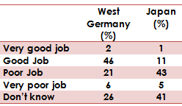
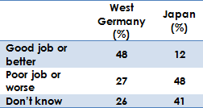
“Collapsing” Response Categories
4.1
Combining the two appropriate range of variation to get better picture or meaningful analyses.
TABLE 4.2: Attitudes toward the United Nations. “ How is the UN doing in solving the problems it has had to face?
TABLE 4.3: Collapsing Extreme Categories
Source. “5-Nation Survey Finds Hope for U.N., New York Times, June 26, 1985, p.6

Slide 16
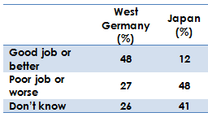
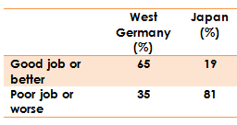
Handling “Don’t Knows”
4.2
Whether to include or exclude the ‘don’t knows’ is harder to decide.
TABLE 4.3: Collapsing Extreme Categories
TABLE 4.4: Omitting the “Don’t Knows”
EXCLUDED
Different / Meaningful interpretation can be made.
But sometimes the “Don’t Knows” is important.
It’s appropriate to report your data in both forms – so your readers can draw their own conclusion.

Slide 17
4.3 Numerical Descriptions in Qualitative Research
The discussions are also relevant to qualitative studies.
The findings off in-depth, qualitative studies often can be verified by some numerical testing.
EXAMPLE:
David Silverman wanted to compare the cancer treatments received by patients in private clinics with those in Britain’s National Health Service.
He primarily chose in-depth analyses of the interactions between doctor & patients.
He also constructed a coding form which enabled him to collate a number of crude measures of doctor & patients interactions.
< Average = 10 to 20 minutes; Average = 21 to 30 minutes; > average = more than 30 minutes

Slide 18
BIVARIATE ANALYSIS
5.0
In contrast to univariate analysis, subgroup comparisons involve two variables.
Subgroup comparisons constitute a kind of bivariate analysis – the analysis of two variables simultaneously.
However, as with univariate analysis, the purpose of subgroup comparisons is largely descriptive.
Most bivariate analysis in social research adds on another element: determining relationships between the variables themselves.

Slide 19

BIVARIATE ANALYSIS
TABLE 5.1: Religious Attendance Reported by Men and Women in 2004
Table describes the church attendance of men & women as
reported in 1990 General Social Survey.
It shows: comparatively & descriptively – that women in the study attended church more often as compared to men.
However, the existence of explanatory bivariate analysis tells a somewhat different story. It suggests: gender has an effect on the church attendance.

Slide 20

BIVARIATE ANALYSIS
Theoretical interpretation of Table 1 in this subtopic might be taken from CHARLES GLOCK’S COMFORT HYPOTHESIS:
Women are still treated as second- class citizens in U.S. society
People denied status gratification in the secular society may turn to religion as an alternative source of status.
Hence, women should be more
religious than men.

Slide 21
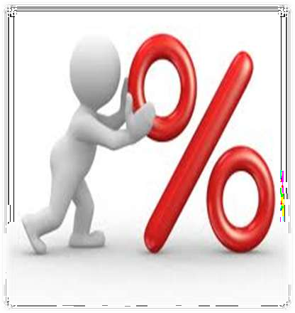
5.1 Percentaging a Table
In reading a table that someone else constructed, one needs to find out which direction it has been percentaged.
Figure 5.1 reviews the logic by which we create percentage tables from two variables.
Variables gender and attitudes toward equality for men and women is used.

Slide 22
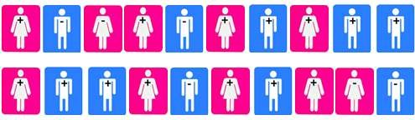
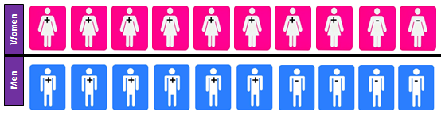
Percentaging a Table (cont’)
Figure 5.1: Percentaging a Table
a. Some men and women who either favor (+) gender equality
or don’t (-) favor it.
b. Separate the men from the women (the independent variable).

Slide 23
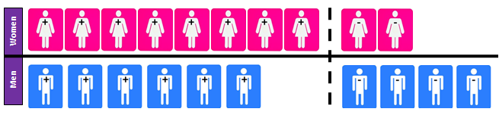
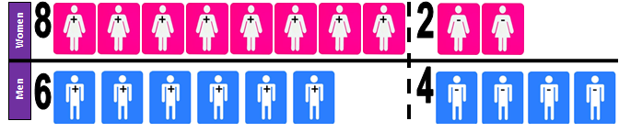
Percentaging a Table (cont’)
c. Within each gender group, separate those who favor equality from
those who don’t (the independent variable)
d. Count the numbers in each cell of the table.

Slide 24
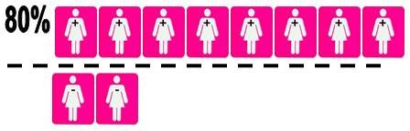
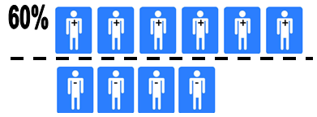
Percentaging a Table (cont’)
e. What percentage of the women favor equality?
f. What percentage of the men favor equality?

Slide 25
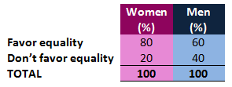
Percentaging a Table (cont’)
g. Conclusion
RULES TO READ TABLE:
If the table percentaged DOWN, read ACROSS.
If the table percentaged ACROSS, read DOWN.
TABLE 5.2: Gender and attitudes toward equality for men and women.
While majority of both men and women favored gender equality, women are more likely than men to do so.
Thus, gender appears to be done of the causes of attitudes
toward sexual equality.

Slide 26

5.2 Constructing and Reading Bivariate Tables
Steps involved in constructing of explanatory bivariate tables
1. The cases | are | divided into | groups
according | to | attributes | of the
independent variable. Each of these subgroups is then described in terms of attributes of the independent variable. Finally, the table is read by comparing the independent variable subgroups with one another in terms of a given attribute of the dependent variable.
TABLE 5.2: Gender and attitudes toward equality for men and women.

Slide 27
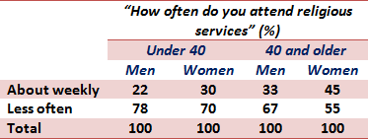
MULTIVARIATE ANALYSIS
6.0
The analysis of the simultaneous relationships several variables.
among
E.g. The effects of Religious Attendance, Gender, and Age
would be and example of multivariate analysis.
TABLE 6.1:
Multivariate Relationship: Religious Attendance, gender, and Age
Age
Gender
Religious Attendance
Source: General Social Survey, 1972 – 2006, National Opinion Research Center.

Slide 28
SOCIOLOGICAL DIAGNOSTICS
7.0
Sociological diagnostics is a quantitative analysis technique for determining the nature of social problems such as ethnic or gender discrimination.
(Babbie, 2010, p. 446)
It can be used to replace opinions with facts and to settle debates with data analysis.
EXAMPLE:
Issues of GENDER and INCOME
Because family pattern, women as group have participated less in in the labor force and many only begin outside the home after completing certain child-rearing
tasks.
28

Slide 29
CONCLUSION
8.0
In quantitative data analysis we classify features, count them, and even construct more complex statistical models in an attempt to explain what is observed.
Findings can be generalized to a larger population, and direct comparisons can be made between two corpora, so long as valid sampling and significance techniques have been used.
Thus, quantitative analysis allows us to discover which phenomena are likely to be genuine reflections of the behavior of a language or variety, and which are merely chance occurrences.

Slide 30
REFERENCES
Assessment Committee. (2009). Quantitative Data Analysis. Unpublished PowerPoint Presentation. Emory University.
Babbie, E. (2010). The Practice of Social Research (Twelfth ed.). California: Wadsworth Cengage Learning.
Gusukuma, I. V. (2012). Basic Data Analysis Guidelines for Research Students. University of Mary Hardin-Baylor.
Hair, Jr., J. F., Money, A. H., Samouel, P., & Page, M. (2007). Research Methods for Business. England: John Wiley & Sons Ltd.

